Slide 1




Diving into Networking

Slide 2

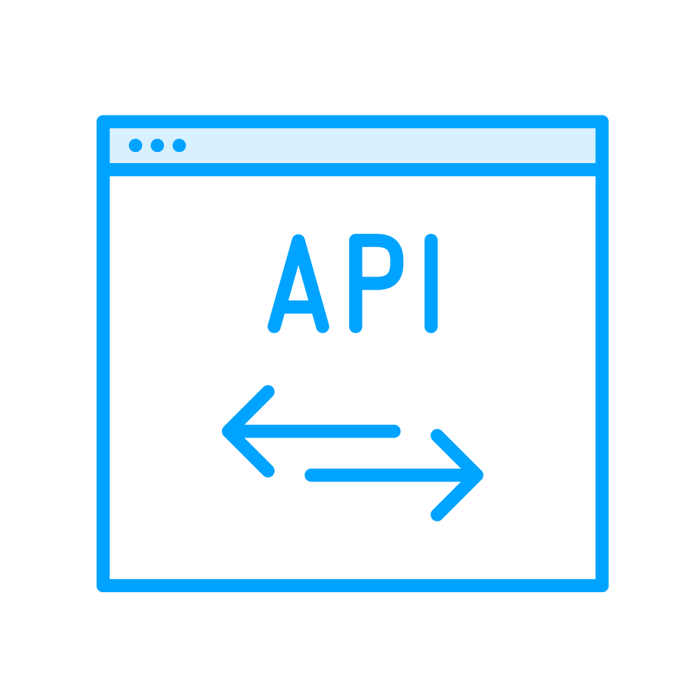


API Testing Use Cases
API-only Testing
(Send Request, Check Response)
API + E2E Testing
(Set state via API, act in UI)
Intercept and mock
(Block or replace Responses)

Slide 3

Overview
HTTP refresher
Request / Response API overview Monitor network activity
Authenticate via HTTP layer Route API

Slide 4

HTTP is the foundation of data communication for the World Wide Web

Slide 5



GET Request
Response
Client, e.g.:
GET .css
Server
Web browser
Playwright
GET .js

Slide 6

GET Request
Response
Header (metadata)
e.g. Status 200 OK
Status 401 Unauthorized Status 404 Not Found
Body with data (payload)
Some requests have it, some don’t

Slide 7
Other widespread HTTP methods:
GET POST PUT DELETE

Slide 8
page.navigate(“http://site.com”);

Slide 9
Response res = page.navigate(“http://site.com”);
// similar in other frameworks Response res = RestAssured.get(url);

Slide 10
// + reload(), goBack(), goForward()
Response res = page.navigate(“http://site.com”);
interface Response { String url();
int status(); boolean ok();
Map<String, String> headers();
byte[] body();
}

Slide 11
page.onDownload(Consumer<Download> handler); page.onConsoleMessage(Consumer<ConsoleMessage> handler);
page.onRequest(Consumer<Request> handler); page.onResponse(Consumer<Response> handler);

Slide 12

Request
Request
Response
.resume()
(with overrides)
.abort()
Request
Response
.fulfill()

Slide 13
r -> r.abort();
page.route(String pattern, Consumer<Route> handler);
**/*
**/*.{png, jpg, jpeg, svg}
**/*.js

